Slide 1
CS 547
JavaScript
Week 13 Day 1

Slide 2
Agenda
Administration
Pillow on mac

Slide 3
Pillow on Mac
If you are using a mac to develop your code you will need to use pip3 to install pillow on a Mac with python 3.x
pip3 should be located in /usr/bin directory

Slide 4
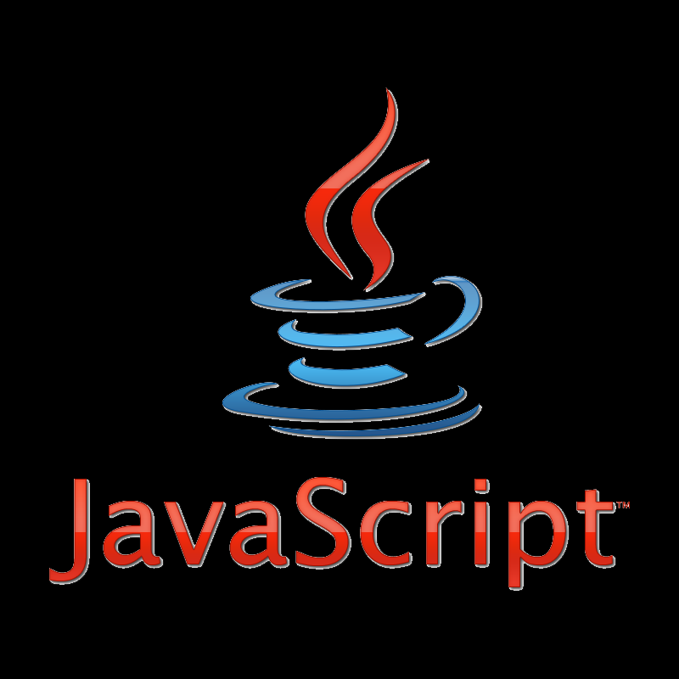
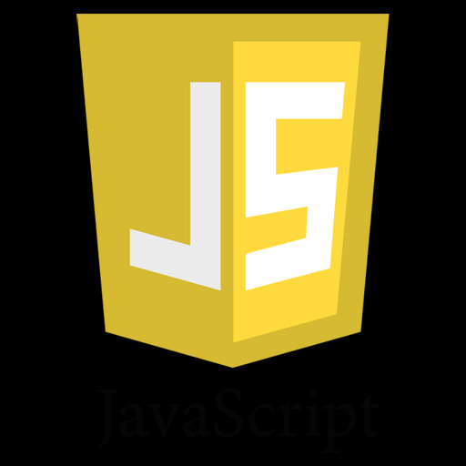
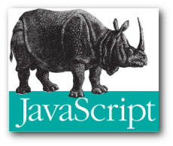




JavaScript

Slide 5
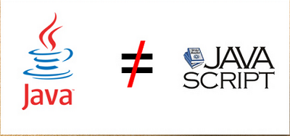
JavaScript

Slide 6
JavaScript: Origins
Origins: Java Scheme Self
JavaScript
Influenced by others including
C Java HyperText Python
Important to understand the Industry Context see the video at the end of the slides

Slide 7
JavaScript
JavaScript also called ECMAScript is a dynamic language originally know as LiveScript
Emerged from the browser wars of the mid 1990’s . Sponsored by Netscape and Sun.
See the second Video for more context
Current version JS is ECAMAScript 5, (ES5) but ES6 is due out this summer.

Slide 8
JS: Origins
JavaScript was originally developed by Brendan Eich, while he was working for Netscape Communications Corporation in about a week and a half.
JS is classified as a prototype based scripting language with dynamic typing and first class functions.
JS is object oriented, but in a slightly different way than in Java.

Slide 9
JS: Things to note
JavaScript is
a full fledged language
an interpreted language
has no native input out functions – is meant to run in a hosted environment

Slide 10
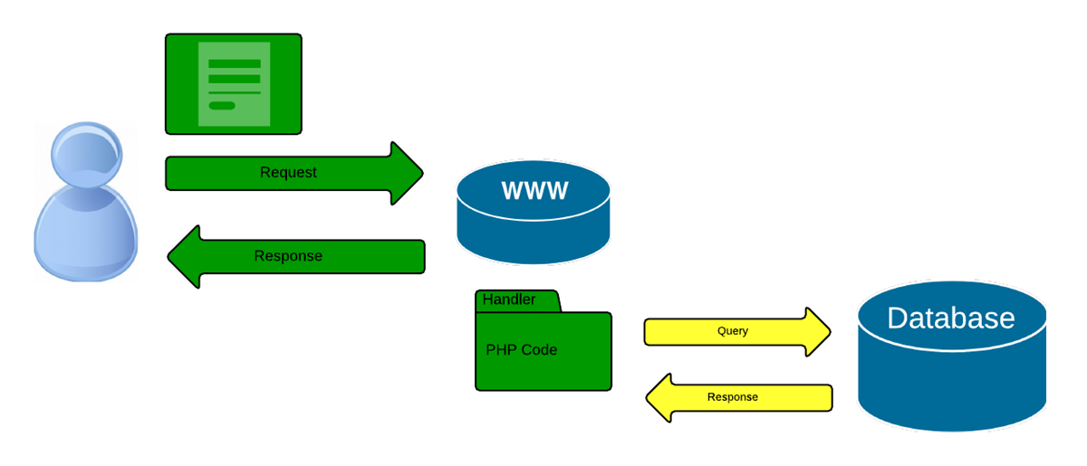
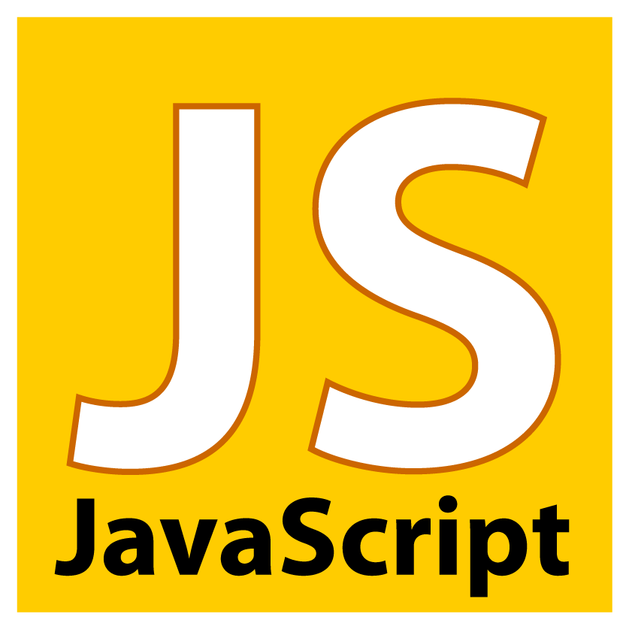
JS: Things to note
runs in a hosted environment.. implies

Slide 11
JS Object Orientated Nature
In JS an object is a dynamic collection of properties.
Every property has a key string that is unique within that object,
* An object in JS is not an instance of a class. *

Slide 12
JS Properties
A property is a named collection of attributes.
value: any JavaScript value
writeable: Boolean
enumerable: Boolean
Configurable: Boolean
get: function () {…return value}
set: function (value) { … }

Slide 13
JS Properties
Two types of properties
Data properties
Accessor properties
Notes:
But before we get into those, let’s look at some of the fundamentals of JS

Slide 14
JS Language Basics
Syntax, Values, Operators, Expressions, Keywords, and Comments
Literals, Variables, Operators, and Key Words
Statements, Expressions and Semi colons
Variables
Numbers, Strings, Arrays, Objects
Objects and Functions
Notes:
But before we get into those, let’s look at some of the fundamentals of JS

Slide 15
JS Syntax Values
Values: JS defines two types: Fixed and Variables
Fixed: (literals)
Numbers 101 0.0003 32Bit integers
Strings- “Jane Doe” ‘John Smith’
Expressions- 12 + 21 6 * 2
Variables:

Slide 16
JS Variables
Variables: used to hold stuff.
var x;
x = 6;
more in a bit

Slide 17
JS Operators
Two broad types, assignment and arithmetic operators
Equal sign ( = ) to assign values
X = 6
Arithmetic ( + - * / % ) are used to compute values
( 5 + 6 ) * 2
Decrement operators ( ++ -- )
X++ --Y

Slide 18
JS Operators
Decrement Assignment operators ( =+ =- =* =/ )
x += 1;

Slide 19
JS Operators Comparison
Operator | Description | Comparing | Returns
== | equal to | x == 8 | false
 |  | x == 5 | true
=== | equal value and equal type | x === "5" | false
 |  | x === 5 | true
!= | not equal | x != 8 | true
!== | not equal value or not equal type | x !== "5" | true
 |  | x !== 5 | false
> | greater than | x > 8 | false
< | less than | x < 8 | true
>= | greater than or equal to | x >= 8 | false
<= | less than or equal to | x <= 8 | true

Slide 20
JS Operators
Unary + and - . This operator precedes its operand and evaluates to its operand but attempts to converts it into a number, if it isn't already. Will return NaN (not a number) if it can not make the conversion.
+3 // 3
+"3" // 3
+true // 1
+false // 0
+null // 0

Slide 21
JS Keywords
abstract | arguments | boolean | break | byte
case | catch | char | class* | const
continue | debugger | default | delete | do
double | else | enum* | eval | export*
extends* | false | final | finally | float
for | function | goto | if | implements
import* | in | instanceof | int | interface
let | long | native | new | null
package | private | protected | public | return
short | static | super* | switch | synchronized
this | throw | throws | transient | true
try | typeof | var | void | volatile
while | with | yield

Slide 22
JS Statements
JS has a set of familiar statements:
Expression
Disruptive
Conditionals- Try, If, and Switch
Loops- While, For, and Do

Slide 23
JS Statements
Expression statements use the var keyword. Also be aware that by default JS puts everything into a Global namespace.
var foo = “bar”;
Blocks of statements us curly brackets { } but the do not create a new scope
{
var foo = “bazz”; // this overwrites the above
}

Slide 24
JS Statements
Disruptive include
break – to break out of a loop or block
return – to exit a function and return control back to the calling function
throw – to raise an error

Slide 25
JS Semi Colons;
A note about semi colons ( ; ). In JS semicolons are optional. The interpreter will fill them in for you. Because of this you should always use them to denote the end of a statement. Consider
function foo(x) {
…
return
true
}

Slide 26
JS Semi Colons;
OR???
function foo(x) {
…
return
true;
}
Did you mean????
function foo(x) {
…
return;
true;
}

Slide 27
JS Comments
Javascript uses C or java style comments:
Single line comments start with // and go to the end of the line
var x = 12; // set x = 12
Block comments are denoted within /* … */ pairs
/* This is
a block
Comment */

Slide 28
JS Statements Conditionals
JS has the regular if else and else if conditional statements
if ( something == true ) {
// do some thing
}
else {
// do something else
}

Slide 29
JS Statements Conditionals
Else If
if (time < 10) { greeting = "Good morning"; } else if (time < 20) { greeting = "Good day"; } else { greeting = "Good evening"; }

Slide 30
JS Statements Conditionals
JS Switch Statement
switch(expression) { case n: code block break; case n: code block break; default: default code block }
switch (new Date().getDay()) { case 1: case 2: case 3: default: text = "Looking forward to the Weekend"; break; case 4: case 5: text = "Soon it be Weekend"; break; case 0: case 6: text = "Weekend!!!"; }

Slide 31
JS Loops
JS has four loop constructs similar to Java
for - loops through a block of code a fixed number of times
while - loops through a block of code while a condition is true
for/in - loops through the properties of an object
do/while - loops while a specified condition is true tests after block is executed

Slide 32
JS Variables
Numbers
Strings
Arrays
Objects

Slide 33
JS Variables Arrays
JS Arrays are declared with [ ] brackets
var cars = [ ‘Honda’, “Toyta” ]; // aka array literal
you can also use the new keyword to declare the array
var cars = new Array[ ‘Honda’, “Toyta” ]; // works but not prefered

Slide 34
JS Variables Arrays
JS Arrays can contain mixed types
var Stuff= [ ‘Honda’, Date.now(), 23];
and you can acess it by index
Stuff[0]; // Honda
Stuff[1];
Stuff [2] ; //23
Notes:
Arrays are objects.

Slide 35
JS Variables Arrays
JS arrays use array.length to get the length of the array
Stuff.length; // returns 3
Notes:
Arrays are objects.

Slide 36
JS Variables Arrays
JS arrays are not associative like in PHP, use objects for that instead
var person = []; person["firstName"] = "John"; person["lastName"] = "Doe"; person["age"] = 46; var x = person.length; // person.length will return 0 var y = person[0]; // person[0] will return undefined
Notes:
Arrays are objects.

Slide 37
JS Objects
In JS everything is an object.
But objects are not like they are in Java.

Slide 38
JS Object Orientated Nature
In JS an object is a dynamic collection of properties.
Every property has a key string that is unique within that object,
* An object in JS is not an instance of a class. *

Slide 39
JS Objects
to create an object use curly brackets
var empty_object = { };
var rockStar= {
firstName : “Freddy”,
lastName : “Mercury”
}

Slide 40
JS Objects
Retrieval: values can be retired in two ways: obj.[“string”] or obj.string
rockstar[“firstName”] // returns “Freddy”
rockstar.lastName; // returns “Mercury”
}

Slide 41
JS Objects
Objects can also contain functions. we will get into that next time.

Slide 42
JS Variables
Numbers, Strings, Arrays, Objects

Slide 43
JS Variables

Slide 44
JS Resources
Videos:
Dougleas Crockford on Javascript https://www.youtube.com/watch?v=JxAXlJEmNMg
This video series provides context and history on the development of JS at 1:37:00 he describes the history computing and what led to the creation of JavaScript
And then there was JavaScript https://www.youtube.com/watch?v=RO1Wnu-xKoY

